Slide 1
3/27 可解釋性報告

Slide 2
1. 不同類別圖片產生的可解釋性圖片

Slide 3
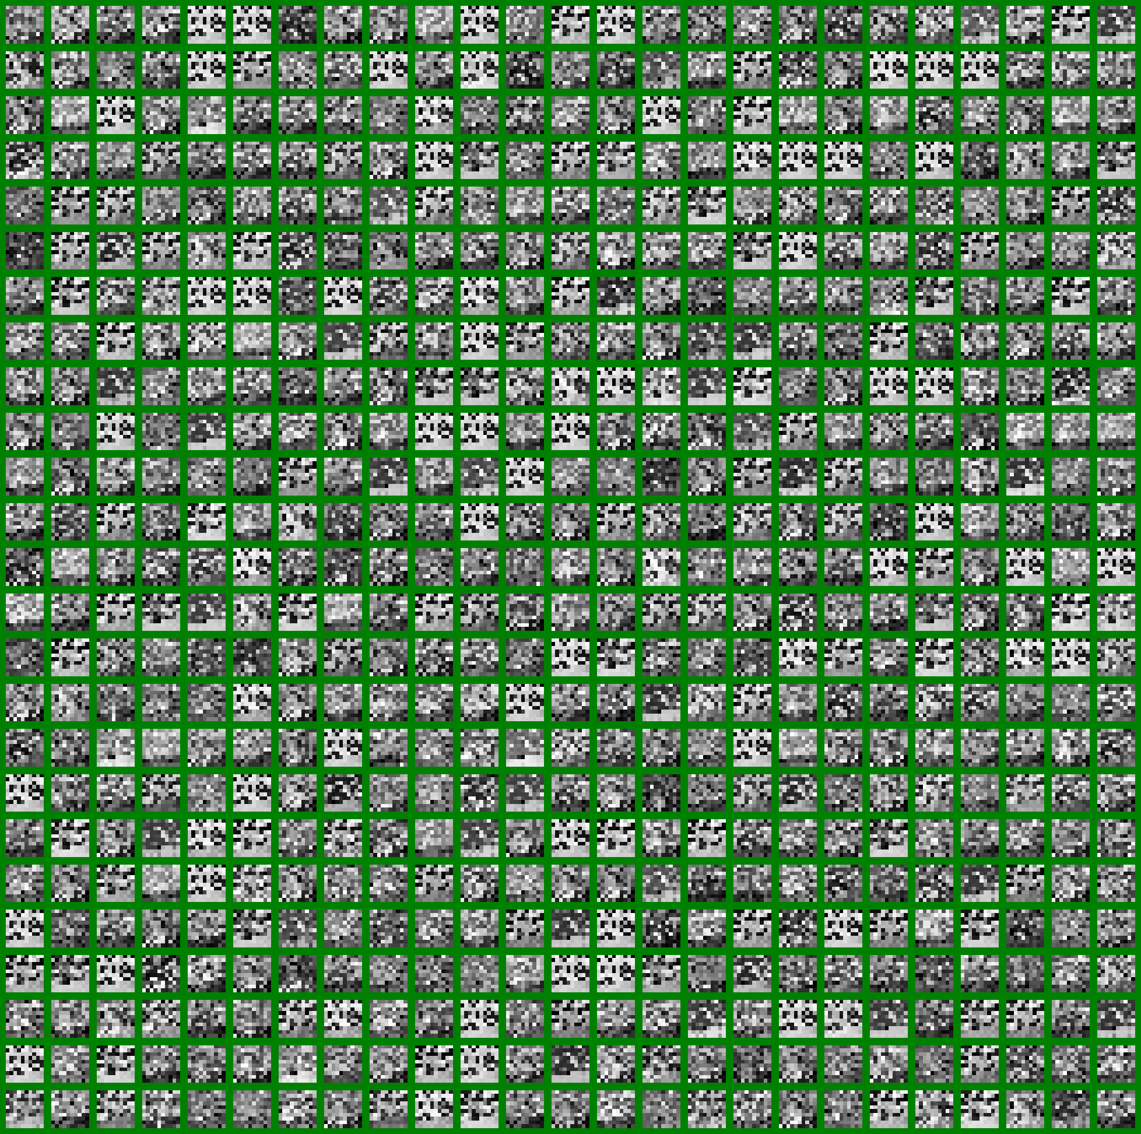
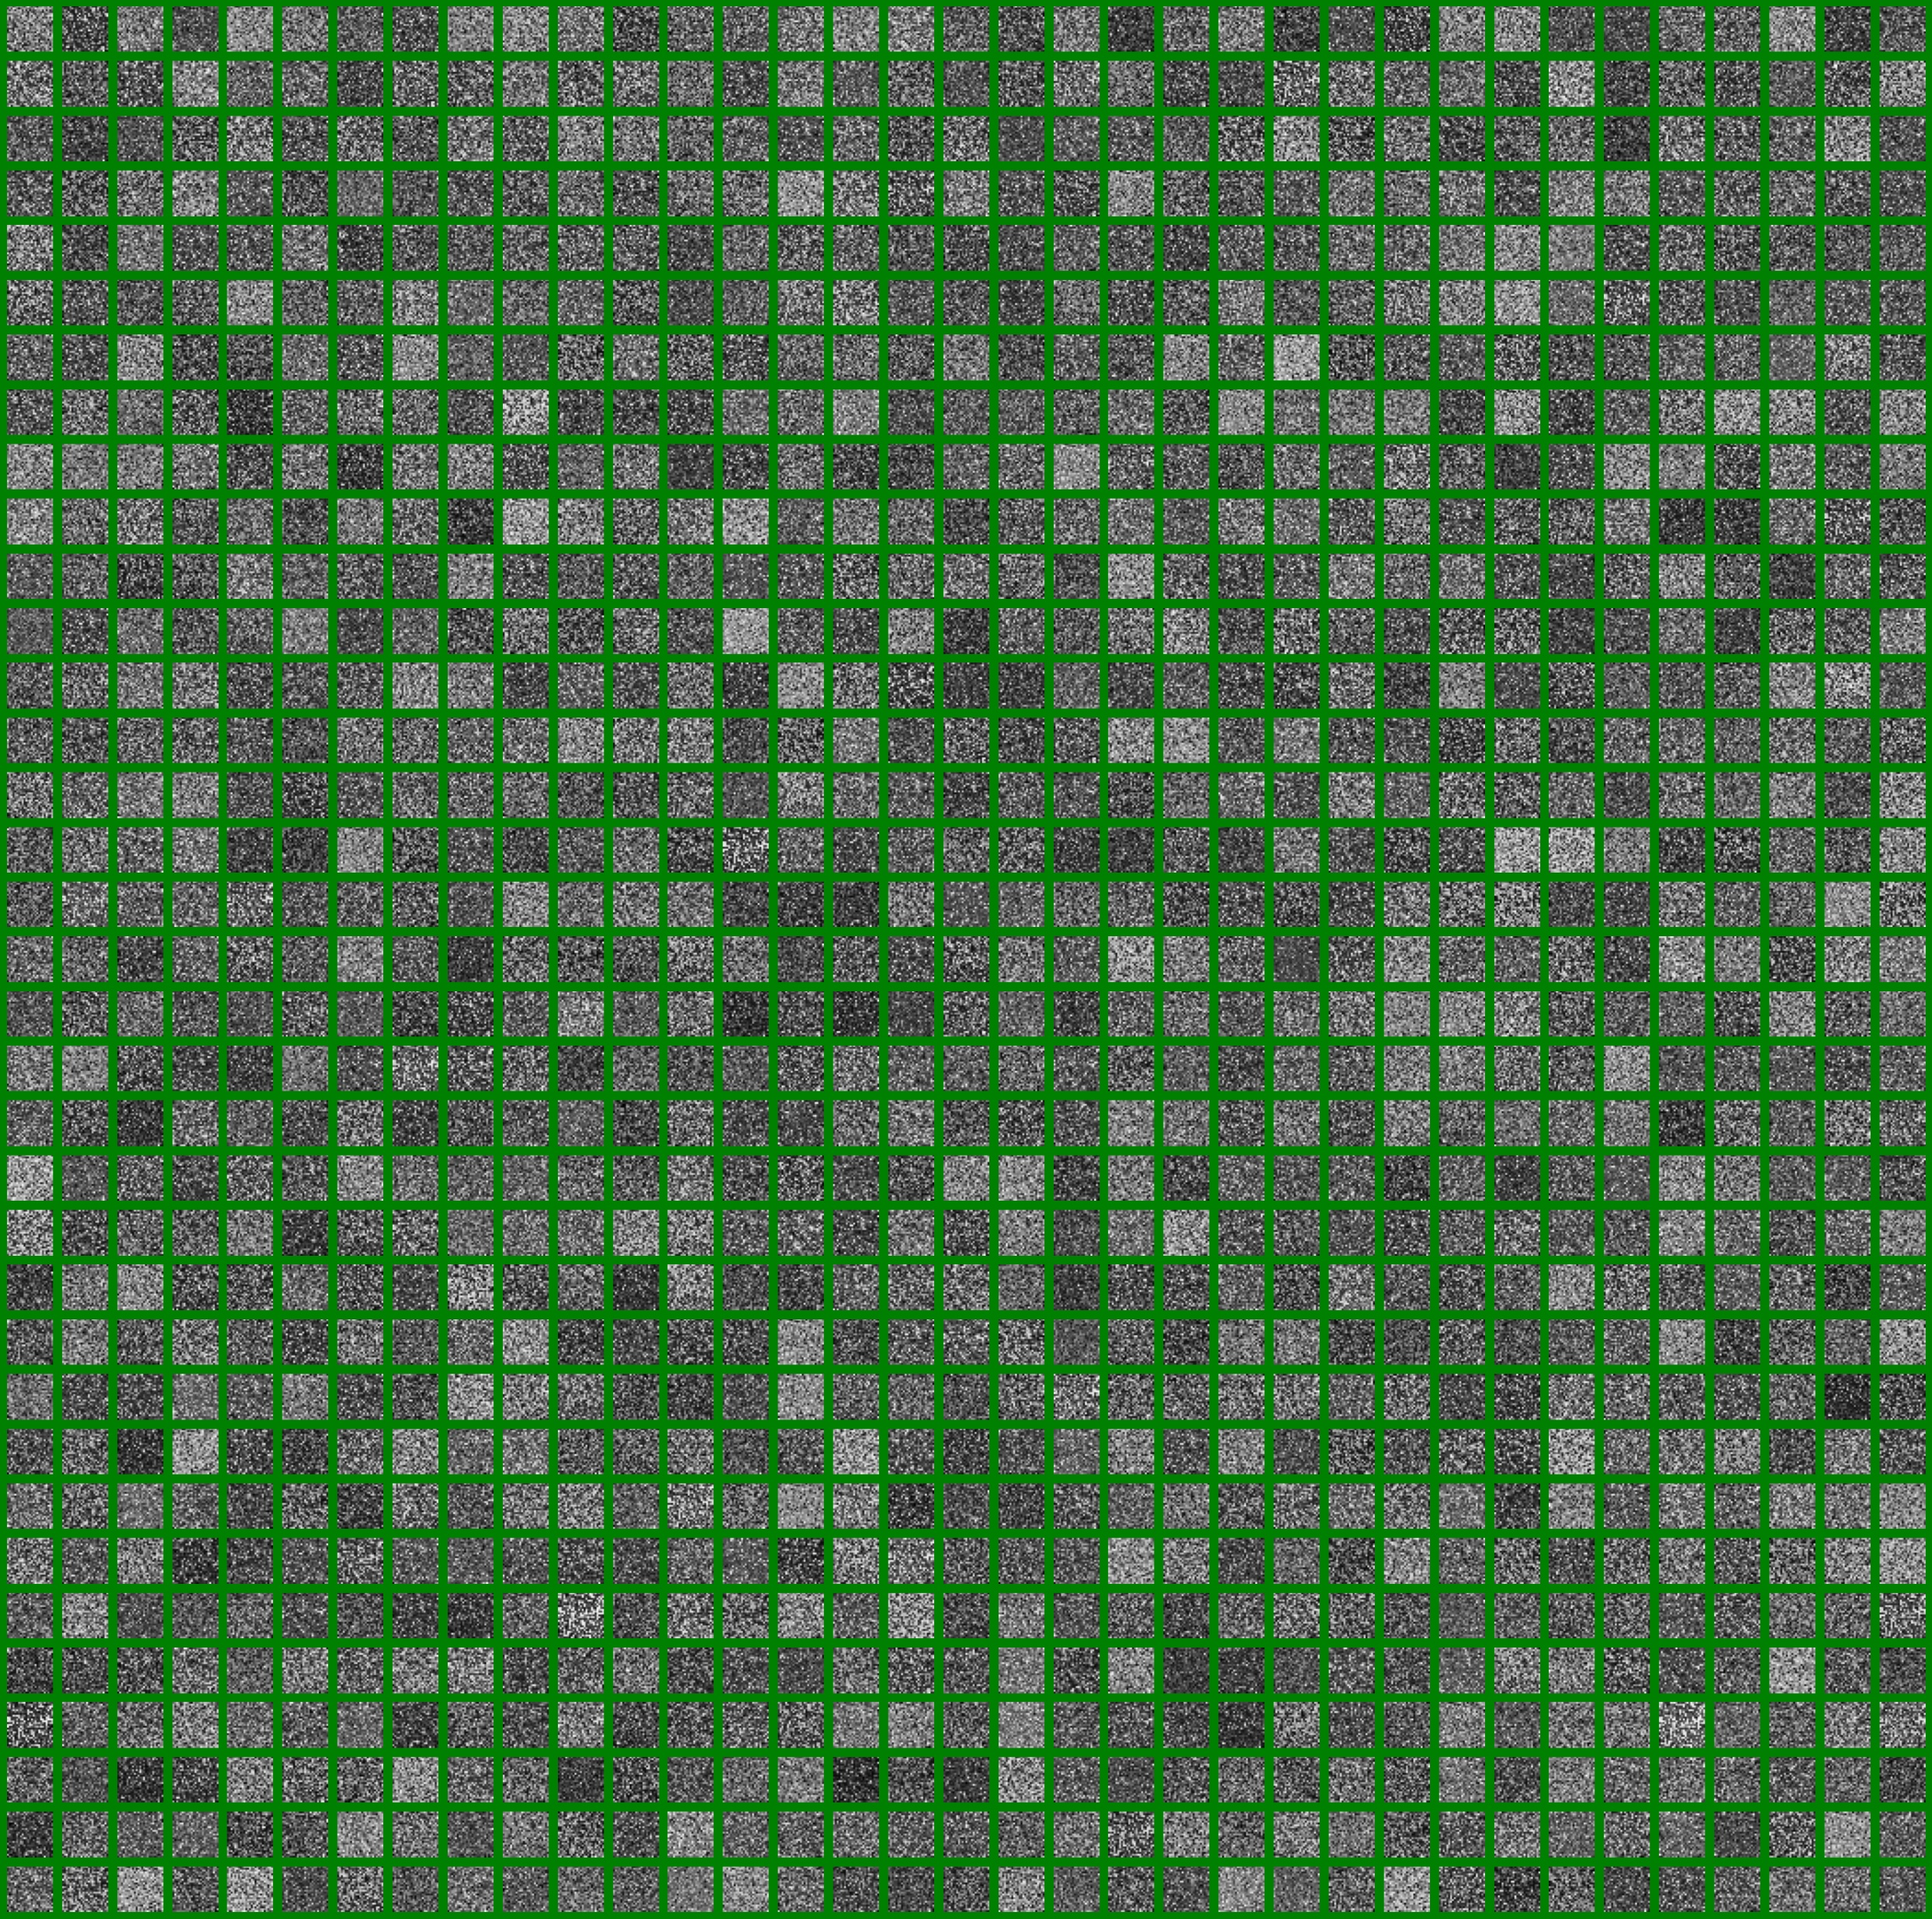
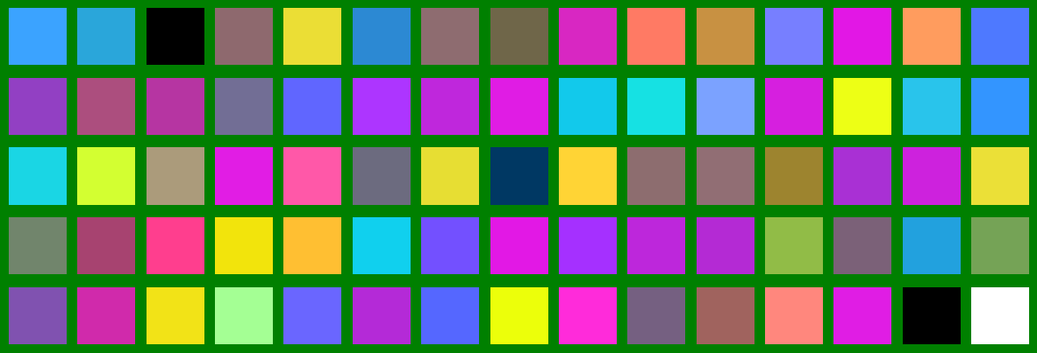
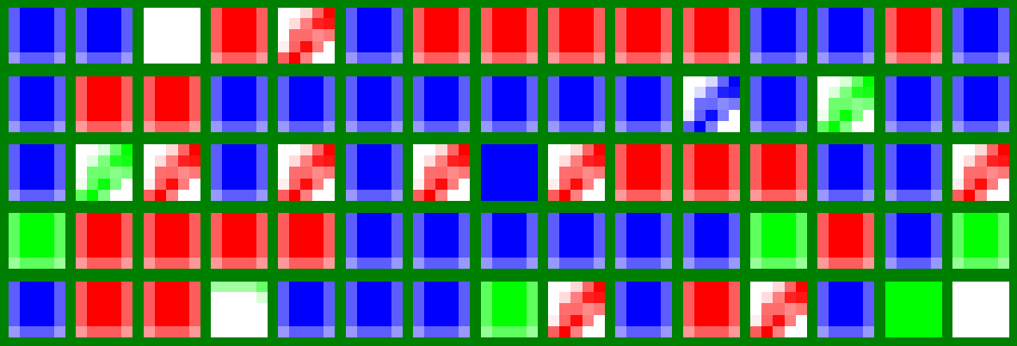
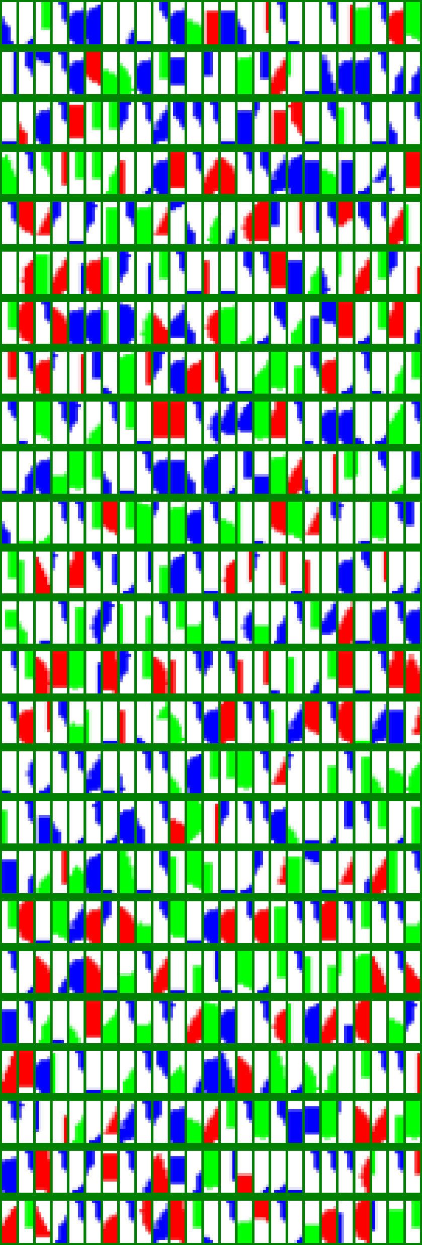
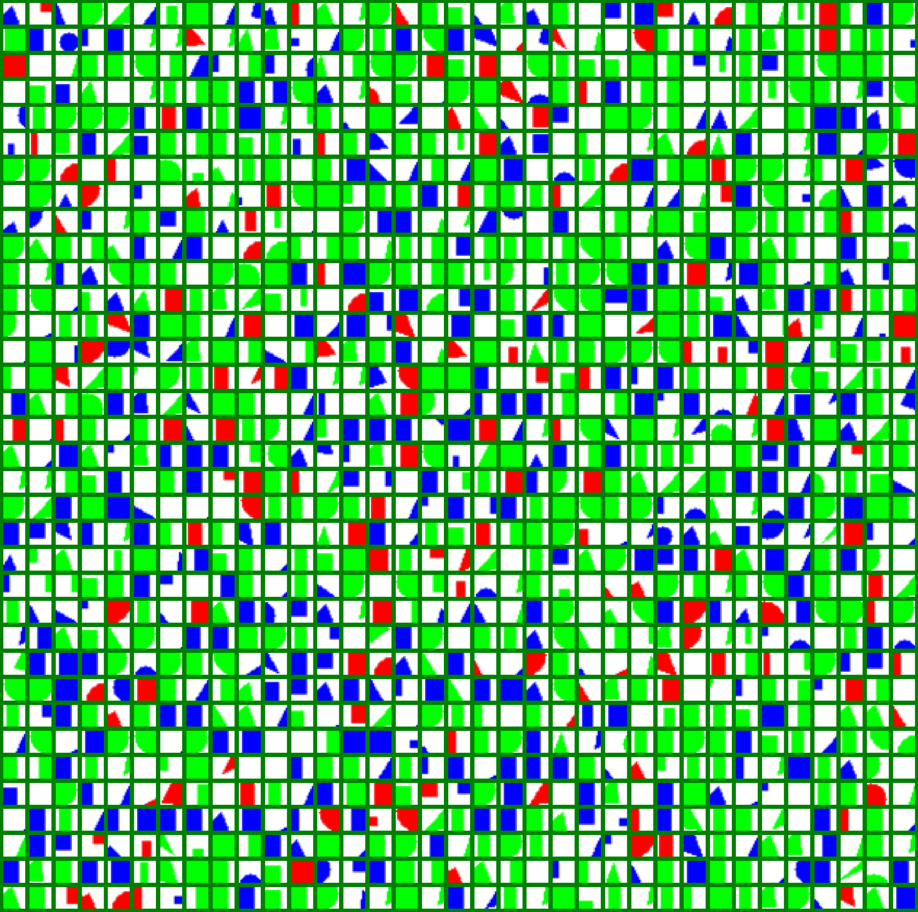
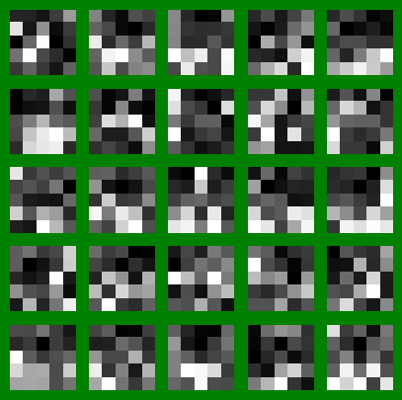
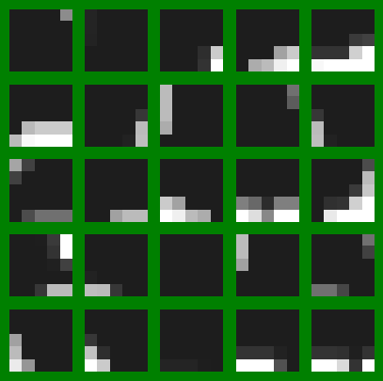
模型固定之可解釋性圖片
FM0_RGB
CI0_RGB
FM1
FM2
FM0_GRAY
CI0_GRAY
CI1
CI2

Slide 4
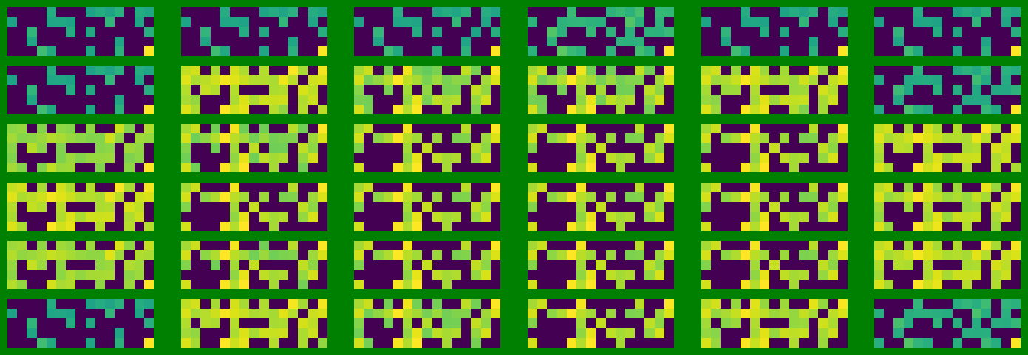

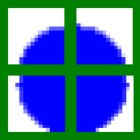
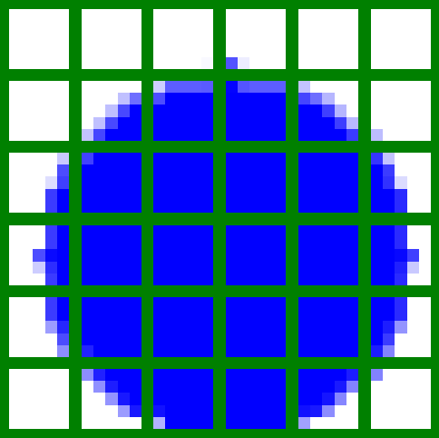
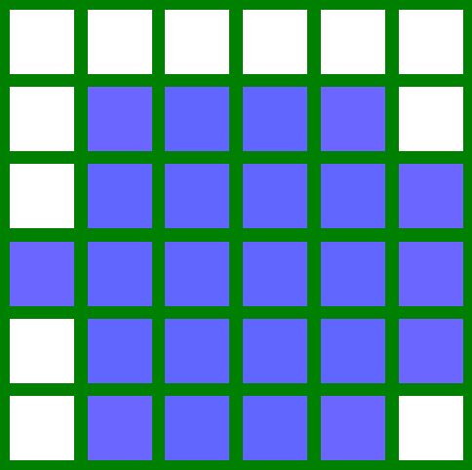
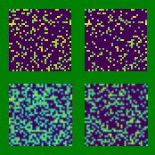
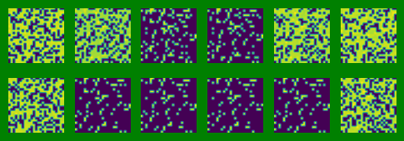
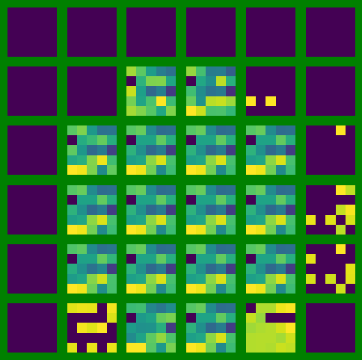
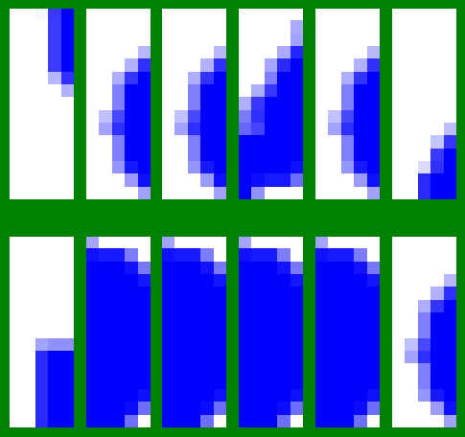
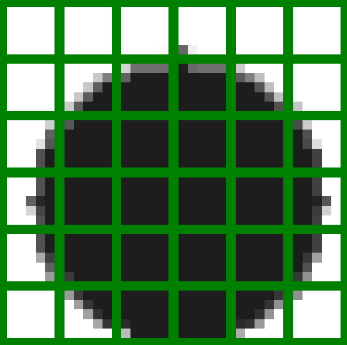
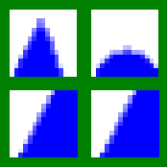
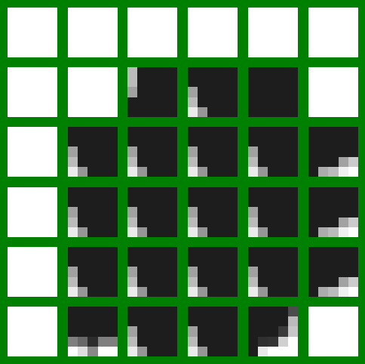
RM0_RGB
Original_split1
Original_split2
Origin Image split
RM-FM0_RGB
RM1
RM2
RM0_Gray
Origin Image split
RM-CI2
RM-CI1
RM-CI0_Gray

Slide 5
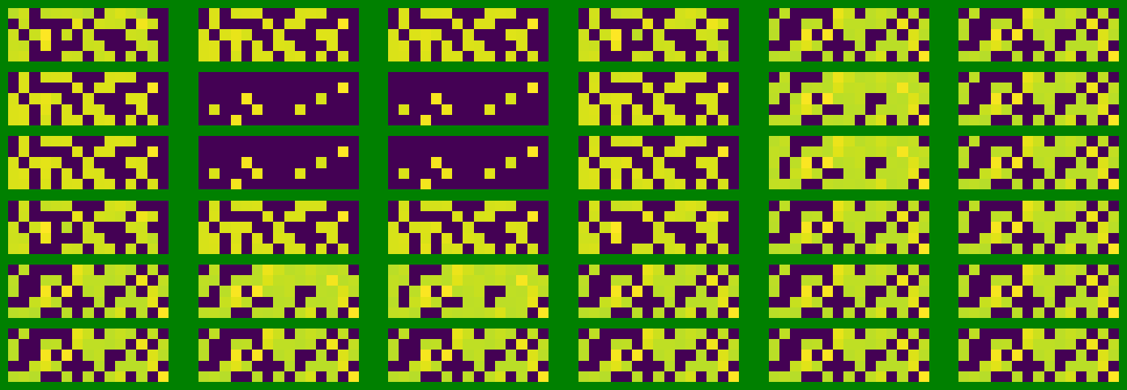


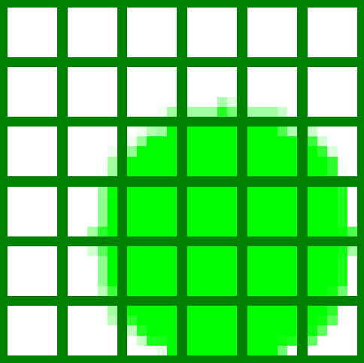
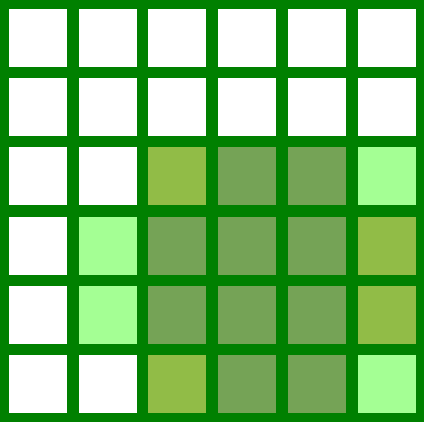
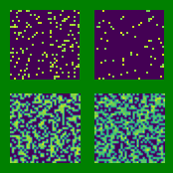
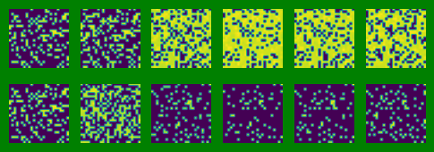
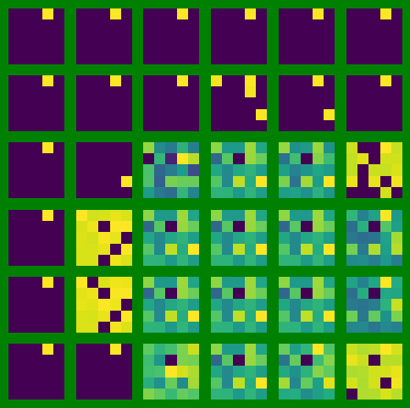
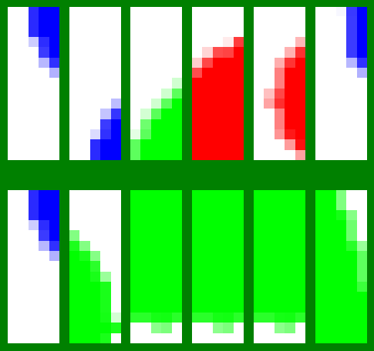
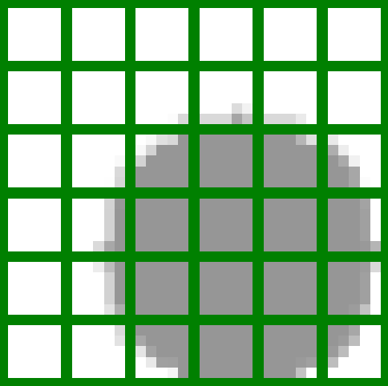
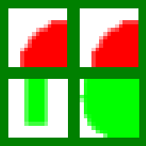
RM0_RGB
Original_split1
Original_split2
Origin Image split
RM-FM0_RGB
RM1
RM2
RM0_Gray
Origin Image split
RM-CI2
RM-CI1
RM-CI0_Gray

Slide 6
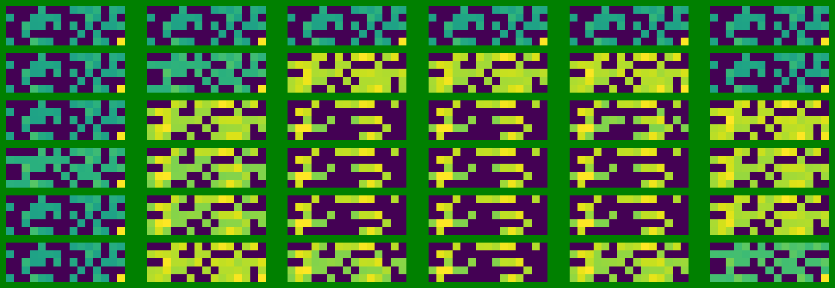
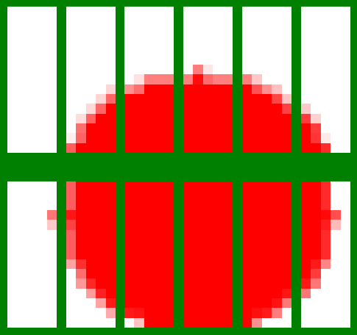
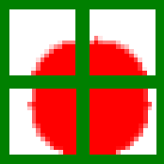
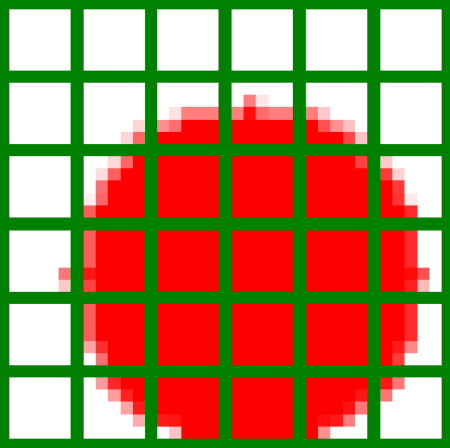
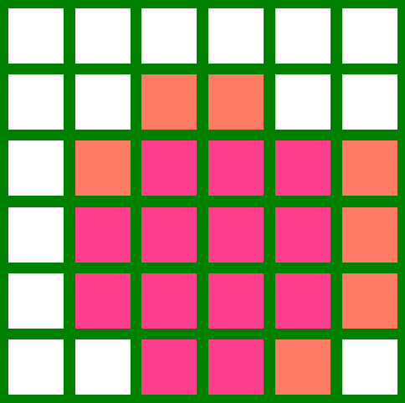
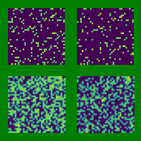
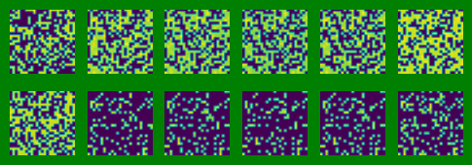
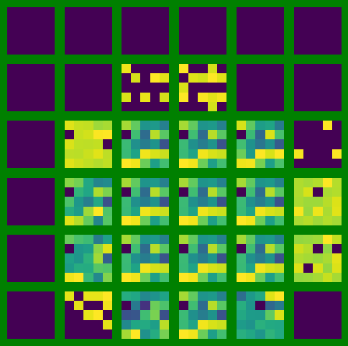
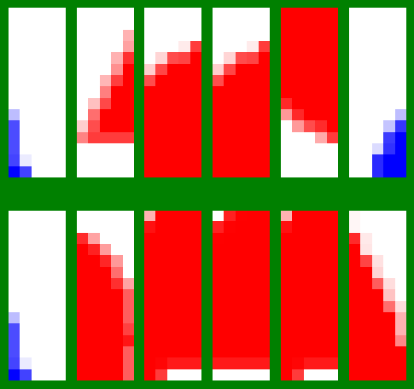
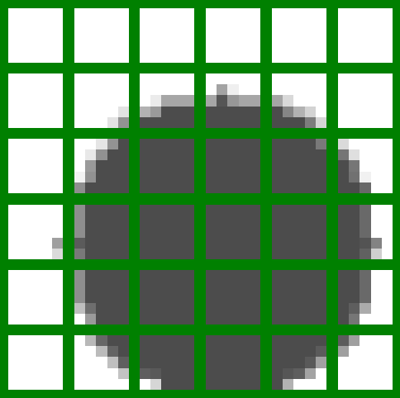
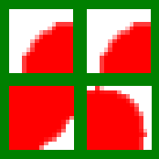
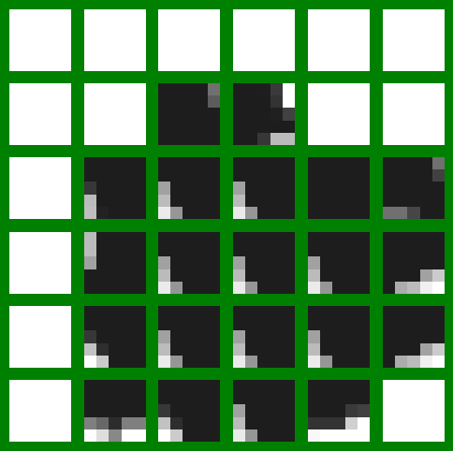
RM0_RGB
Original_split1
Original_split2
Origin Image split
RM-FM0_RGB
RM1
RM2
RM0_Gray
Origin Image split
RM-CI2
RM-CI1
RM-CI0_Gray

Slide 7
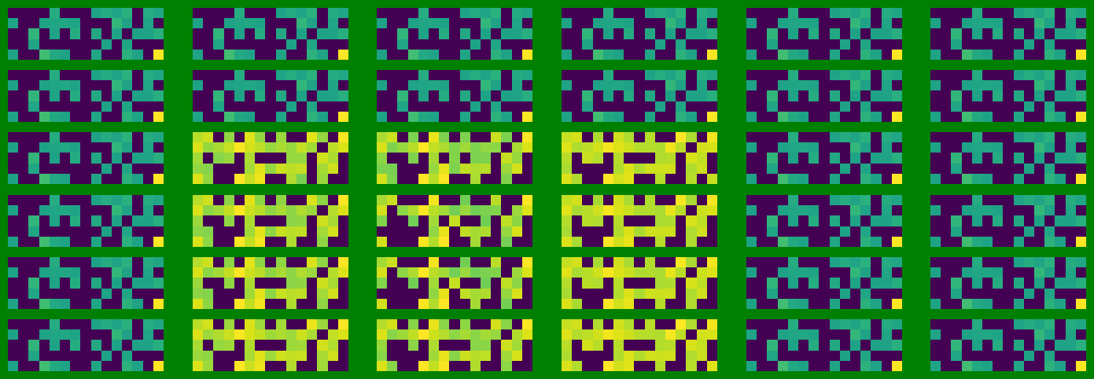
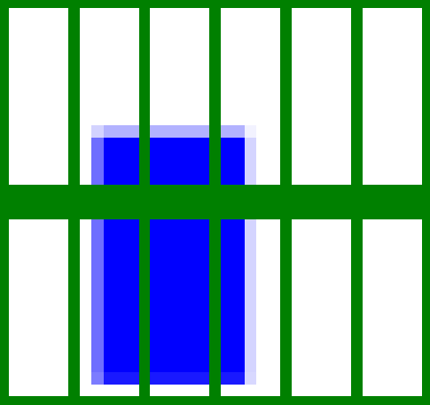
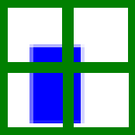
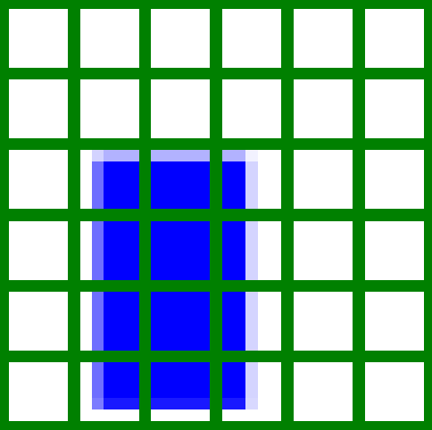
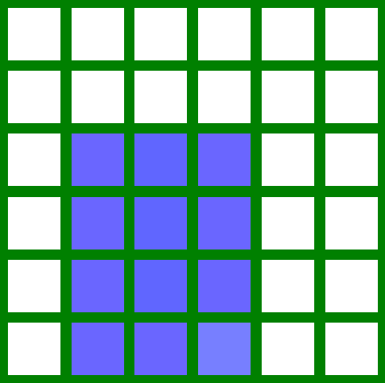
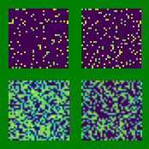
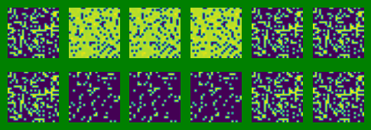
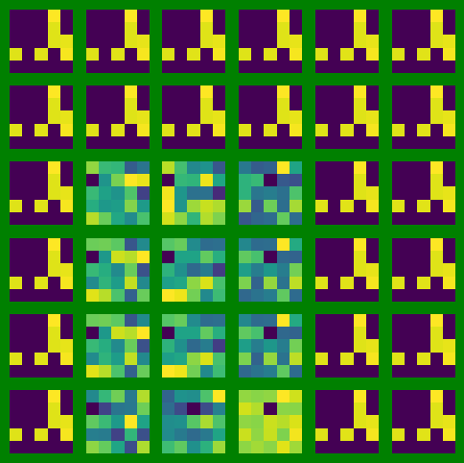
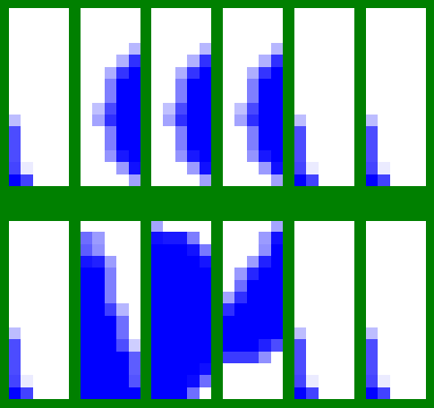
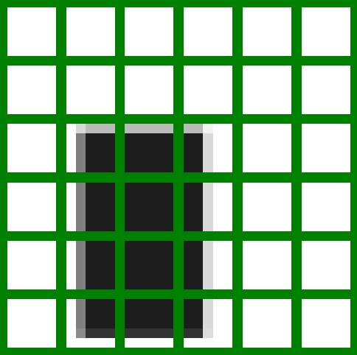


RM0_RGB
Original_split1
Original_split2
Origin Image split
RM-FM0_RGB
RM1
RM2
RM0_Gray
Origin Image split
RM-CI2
RM-CI1
RM-CI0_Gray

Slide 8












RM0_RGB
Original_split1
Original_split2
Origin Image split
RM-FM0_RGB
RM1
RM2
RM0_Gray
Origin Image split
RM-CI2
RM-CI1
RM-CI0_Gray

Slide 9












RM0_RGB
Original_split1
Original_split2
Origin Image split
RM-FM0_RGB
RM1
RM2
RM0_Gray
Origin Image split
RM-CI2
RM-CI1
RM-CI0_Gray

Slide 10












RM0_RGB
Original_split1
Original_split2
Origin Image split
RM-FM0_RGB
RM1
RM2
RM0_Gray
Origin Image split
RM-CI2
RM-CI1
RM-CI0_Gray

Slide 11












RM0_RGB
Original_split1
Original_split2
Origin Image split
RM-FM0_RGB
RM1
RM2
RM0_Gray
Origin Image split
RM-CI2
RM-CI1
RM-CI0_Gray

Slide 12












RM0_RGB
Original_split1
Original_split2
Origin Image split
RM-FM0_RGB
RM1
RM2
RM0_Gray
Origin Image split
RM-CI2
RM-CI1
RM-CI0_Gray

Slide 13
2. 推論成果

Slide 14





推論方法
RM-CI
CI Block
對應的原始Image
相似度
(計算歐氏距離)
推論類別:
circle_blue
Origin-Image-split

Slide 15


推論成果
Test 900 張
只採用Gray_conv的推論類別 => accuracy: 13.44%
只採用Conv1的推論類別 => accuracy: 36.78%

Slide 16



推論成果
Test 900 張
採用每個layer依推論類別進行投票
如果票數相同，則以Conv2的推測類別為預測推論類別
=> accuracy: 43.56%, color accuracy: 82.56%, shape accuracy:52.23%

Slide 17





現有問題
RM-CI
CI Block
對應的原始Image
相似度
(計算歐氏距離)
推論類別:
triangle_red
Origin-Image-split

